Slide 1
Nonlinear Equations in One Variable
(Fixed Point Iteration Method)
Lecture-3

Slide 2
Objective:
To find the root of a nonlinear equation in on variable with the help of Fixed point iteration methods.

Slide 3
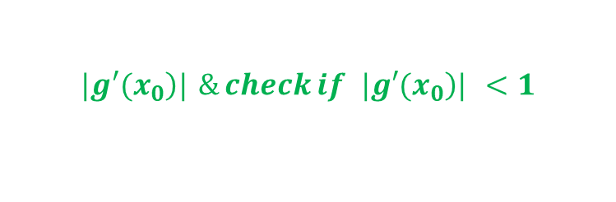



Fixed Point Iteration Method
A fixed point of a function
is a real number α such that
This means α is a root of the equation
Algorithm:
Step 1: Consider nonlinear equation f(x)=0
Step 2: Rewrite the given equation as follows:
$$x=g(x) (NOT UNIQUE)$$
Step 3: Find
$$|\left.g′(x_{0}\right)| \& check if |\left.g′(x_{0}\right)| <1$$
Step 4: Initial guess compute
$$x_{n+1}=g(x_{n}) ,\text{where} n=0,1,2,...,n$$
$$x_{0}$$

Slide 4



Step 5: Then calculate
by using initial guess value and continue this process till
$$|x_{n+1}−x_{n}|≤ε$$
$$x_{1}$$
where is the specified accuracy.
$$ε$$

Slide 5


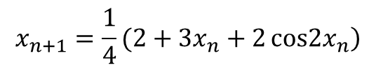
Problems and Solutions
Example:
Given that
$$f(x)=2 cos2x+2−x$$
An iterative formula
$$x_{n+1}=\frac{1}{4}(2+3x_{n}+2\cos\left.2x_{n}\right)$$
can be used to estimate the root of
$$f(x)=0$$
State with reason whether the iterative formula will converge to the root near $x_{0}=3.5$.
ii. If the iterative formula converges to the root do the iteration two times to estimate the root to 3 decimal places
iii. Write down MATLAB commands to execute the iterations five times
Solution:
i. Consider
Let,

Slide 6
Calculate
We have, x0=3.5, so consider n=0 and we get
[Substitute the value of x0]
The sequence will converge because
ii. 1st iteration: We have, x0=3.5, so consider n = 0 then Eq. (2) become
[Substitute the value of x0]

Slide 7
2nd iteration: We have now, x1=3.501951, so consider n=1 then Eq. (2)
become
[Substitute the value of x1]
iii. MATLAB CODE
f=@(x) (2+3*x+2*cos(2*x))/4;
x(1)=3.5;
for n=1:5
x(n+1)=f(x(n));
end
Output: Solution = x
3.5000 3.5020 3.5021 3.5021 3.5021 3.5021

Slide 8
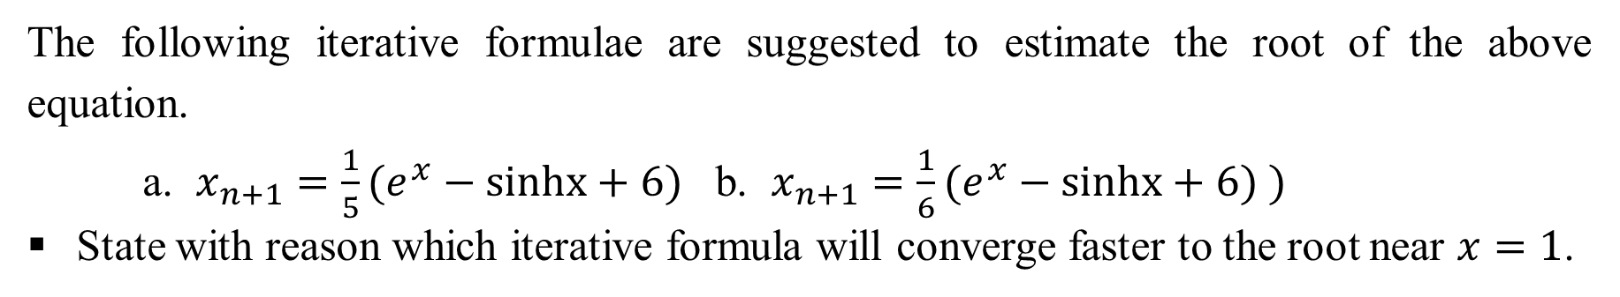
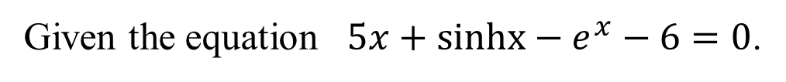
Exercise
Given the equation $5x+sinhx−e^{x}−6=0$.
The following iterative formulae are suggested to estimate the root of the above equation.
a. $x_{n+1}=\frac{1}{5}(e^{x}−sinhx+6)$ b. $x_{n+1}=\frac{1}{6}(e^{x}−sinhx+6) )$
State with reason which iterative formula will converge faster to the root near $x=1$.
Use the suitable iterative formula from the above two (a) and (b) to find the root correct to 2 decimal places.
Write MATLAB codes to execute the above iterative formula in five times.

Slide 9
Advantages and Drawbacks: Fixed Point Iteration Method
Advantages:
Fast
Fewer calculations than bracketing methods
Requires one guess only
Easier to program
Drawbacks:
Convergence is not guaranteed

Slide 10
Outcome
By applying Fixed point iteration method, nonlinear equations in one variable can be solved to find roots (approximately) of the equation, although it has few drawbacks.

Slide 11
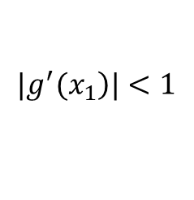

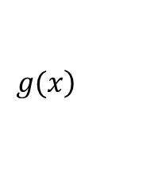
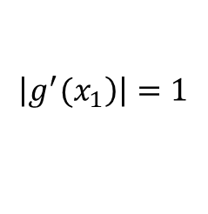
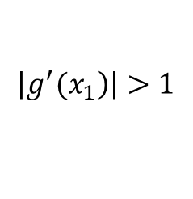
Multiple Choice Questions
$$\left.x_{n+1}=g(x_{n}\right) \text{converges} \text{if}$$
1. The fixed point iteration method defined as
a) , b) , c) d) Neither
$$|\left.g^{′}(x_{1}\right)|<1$$
$$\left|\left.g^{′}(x_{1}\right)\right|>1$$
$$\left|\left.g^{′}(x_{1}\right)\right|=1$$
2. Fixed Point Iteration method can be used to find roots of the following system of equations:
a) Linear equations , b) Non-linear equations , c) both (a) and (b) d) Neither
$$\left.g(x\right)$$
3. A point, say, α is called a fixed point of a function for which of the following condition-
a) if it satisfies the equation α = g(α).
b) if it does not satisfy the equation α = g(α).
c) both a) and b)
d) Neither

Slide 12
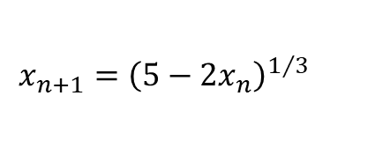

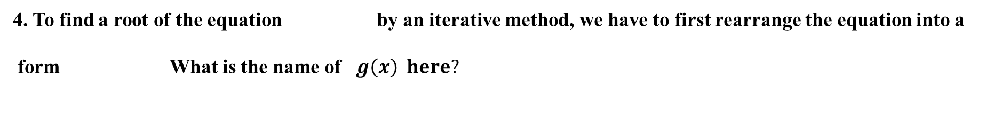


4. To find a root of the equation by an iterative method, we have to first rearrange the equation into a
form What is the name of $g\left(x\right) here?$
$$f(x)=0$$
$$x=g(x).$$
a) iteration function
b) non-iteration function
c) both a) and b)
d) Neither
5. If the equation
$$x^{3}+2x−5=0$$
has a root near
$$x=1.4. Which of the following can be an \text{iteration} \text{formulae}\text{ ?}$$
a)
$$x_{n+1}={\left(5−2x_{n}\right)}^{1/3}$$
b)
c) both a) and b)
d) Neither

